Slide 1

Football commentary Using Machine Learning
Krish Lalwani 6298930470
Mohak Wagh 3430937395
Pranali Majmundar 5170114428

Slide 2
GOAL
Develop a language model by fine tuning existing GPT-2 model on football data extracted from YouTube videos
Produce football commentary on-the-fly
Generate commentary for Google Research Football Environment based on prompts given by the current game state
Aim to generate ‘parody’ commentary by augmenting training data

Slide 3
Environment Selection
Chosen the Google Research Football (GRF) Environment
Originally released to perform Reinforcement Learning
Open-source (https://github.com/google-research/football)
Various modes available which can be taken control of
Generates play-by-play information about the current state of the game
GRF Environment currently only supports Linux and Python 3

Slide 4
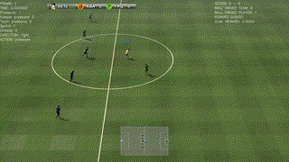
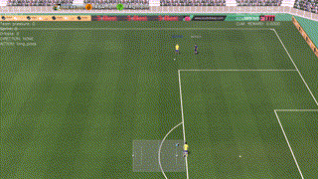
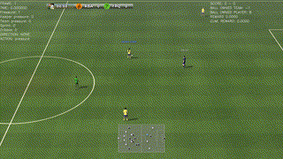
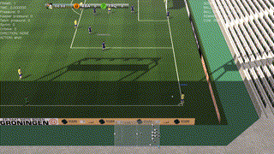

Slide 5
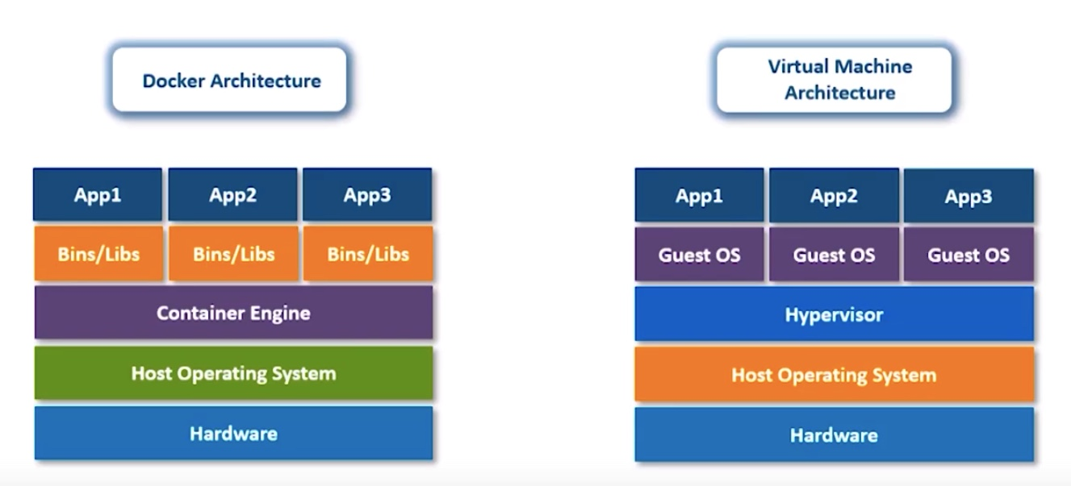
Docker
For MacOS options available: Docker or Virtual Machine
Docker chosen for simple implementation without GRF GUI
Docker packages software in containers
Each container has all the libraries and dependencies required for the software to run
For MacOS, we import Ubuntu and gfootball containers

Slide 6
Google research football environment
Ran a reinforcement learning algorithm on GRF
Provides game information as output on terminal
Output contains - ball position, player positions and home/away team scores
Prompts will be generated based on this output
Fed to the language model to produce commentary

Slide 7
MODEL SELECTION
Using OpenAI’s GPT-2 model
GPT-2 is a large transformer based language model
Predicts the next word
Largest model trained on 40GB of internet text from 8 million web pages
Implementations available: 117M, 345M (open – source) and 1.5B parameters (not publicly available)

Slide 8
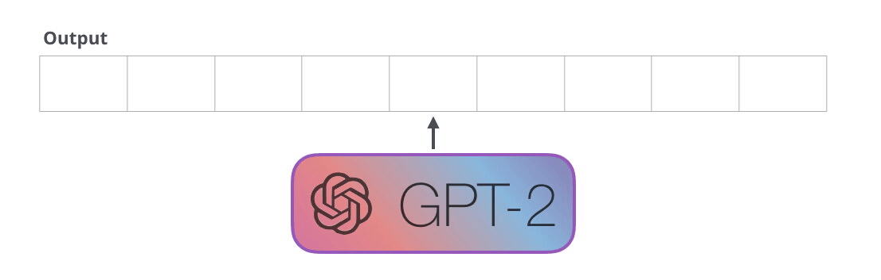
GPT-2
Outputs one token at a time
After each token is produced, it is added to the sequence of inputs
New sequence becomes the input to the model in its next step

Slide 9
LIBRARIES implemented
Tried both Keras and pure TensorFlow implementations
The original model made open-source by OpenAI is in TF: https://github.com/nshepperd/gpt-2
Keras implementation is a python package called keras-gpt-2: https://github.com/CyberZHG/keras-gpt-2

Slide 10
Methodology - I
Data gathering:
Gathered YouTube videos of FIFA/PES games, live football matches and football blogs
Implemented a Python program using the youtube_dl and webvtt modules to scrape auto-generated subtitles from Youtube videos.
Accumulated data in a .txt file
Converted it to a .npz (numpy compressed array) format to retrain the GPT-2 model in TF

Slide 11
Methodology - II
Ran the gfootball Docker container
Applied Proximal Policy Optimization Algorithm (11v11 reinforcement learning algorithm)
Algorithm used to return game information to the terminal to be used as prompts for the language model

Slide 12
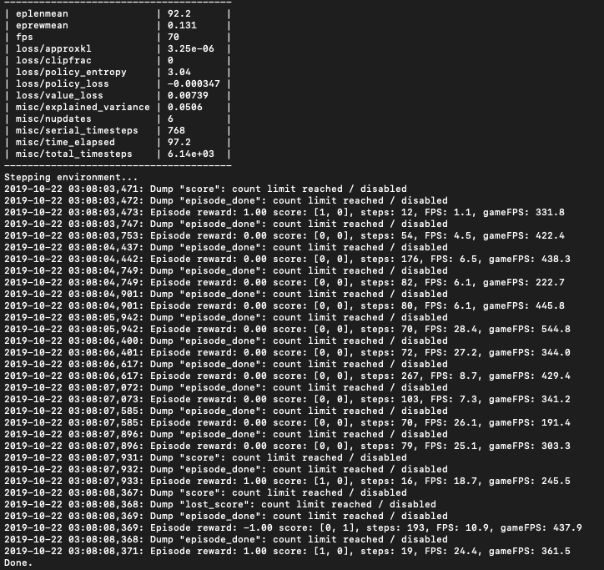
Game information

Slide 13
Methodology - III
Keras Implementation for GPT-2 model:
For Keras, used the keras-gpt-2 package
Implemented the 117M and 345M parameters open-source model.
117M generated relevant but incomplete commentary
345M generated relevant commentary, took longer but performed better
Added text-to-speech function using pyttsx3 library
Tried various prompts as shown

Slide 14
Methodology - IV
TensorFlow Implementation for GPT-2 model:
Downloaded model
Encoded custom commentary dataset as a .npz file (Numpy compressed array format)
Fine-tuned model on custom dataset for 1000 epochs
Added text-to-speech function using pyttsx3 library
Tried various prompts as shown

Slide 15
Next steps
Connect live GRF environment to language model to create prompts
Improve training data as current training data lacks punctuations due to web scraping
Try optimizing Keras implementation as it is slow
Requires Byte Pair Encoding of text data for fine-tuning
Freezing certain layers of the model
Training on BPE encoded commentary data
Train on parody data if achievable
Try GUI implementation with Virtual Machine as actual gameplay and subsequent commentary can be shown

Slide 16
THANK YOU

